Slide 1
The Product Life Cycle Ontologies: An Overview
Quick Facts:
Produced by: The Coordinated Alignment of Manufacturing Process (CHAMP) project, sponsored by DMDII.
Created: 2017-2018
Creators: J. Neil Otte, Ron Rudnicki, Munira Binti Mohd Ali, Binbin Zhang, Ruoyu Yang, and Barry Smith.
Available here: https://github.com/NCOR-US/CHAMP
Purpose: To serve as a suite of reference ontologies for the product life cycle.

Slide 2
Top-Level Ontology
IOF Ontologies
Domain Independent Reference Ontologies
e.g. time, location, measurement, process, information types…
Domain Specific Reference Ontologies
e.g. logistics, manufacturing, maintenance, design, materials, production plans, recycling…
Domain Dependent Ontologies
Application Ontologies

Slide 3
Top-Level Ontology
IOF Ontologies
Domain Independent Reference Ontologies
e.g. time, location, measurement, process, information types…
Domain Specific Reference Ontologies
e.g. logistics, manufacturing, maintenance, design, materials, production plans, recycling…

Slide 4
Basic Formal Ontology (BFO)
IOF Ontologies
The Common Core Ontologies (CCO)
The Product Life Cycle Ontologies (PLC)

Slide 5
Basic Formal Ontology (BFO)
IOF Ontologies
The Common Core Ontologies (CCO)
The Product Life Cycle Ontologies (PLC)
Application Ontology 1
Application Ontology 1
Application Ontology 1
Application Ontology 1
Application Ontology 1
descends from
Goal 1: Re-use

Slide 6
Basic Formal Ontology (BFO)
IOF Ontologies
The Common Core Ontologies (CCO)
The Product Life Cycle Ontologies (PLC)
Goal 2: orthogonal compatibility
Application Ontology 1
Application Ontology 1
Application Ontology 1
Application Ontology 1
Application Ontology 1

Slide 7
Basic Formal Ontology
BFO
The Common Core Ontologies Suite
CCO
Extended Relation Ontology
Geospatial Ontology
Time Ontology
Information Entity Ontology
Event Ontology
Quality Ontology
Agent Ontology
Artifact Ontology
Units of Measure Ontology
Currency Unit Ontology
Modal Relation Ontology
All Core Ontology
Notes:
What we are presently missing here is an end-of-life domain ontology that would cover disposal and recycling.

Slide 8
Basic Formal Ontology
BFO
The Product Life Cycle Ontology Suite
CCO
Extended Relation Ontology
PLC
Geospatial Ontology
Time Ontology
Information Entity Ontology
Event Ontology
Quality Ontology
Agent Ontology
Artifact Ontology
Units of Measure Ontology
Currency Unit Ontology
Modal Relation Ontology
All Core Ontology
All CHAMP Ontology
Services Ontology
Design Ontology
Testing Processes Ontology
Maintenance Process Ontology
Manufacturing Processes Ontology
Machine and Tool Ontology
Commercial Entities Ontology
Product Life Cycle Ontology
Notes:
What we are presently missing here is an end-of-life domain ontology that would cover disposal and recycling.

Slide 9
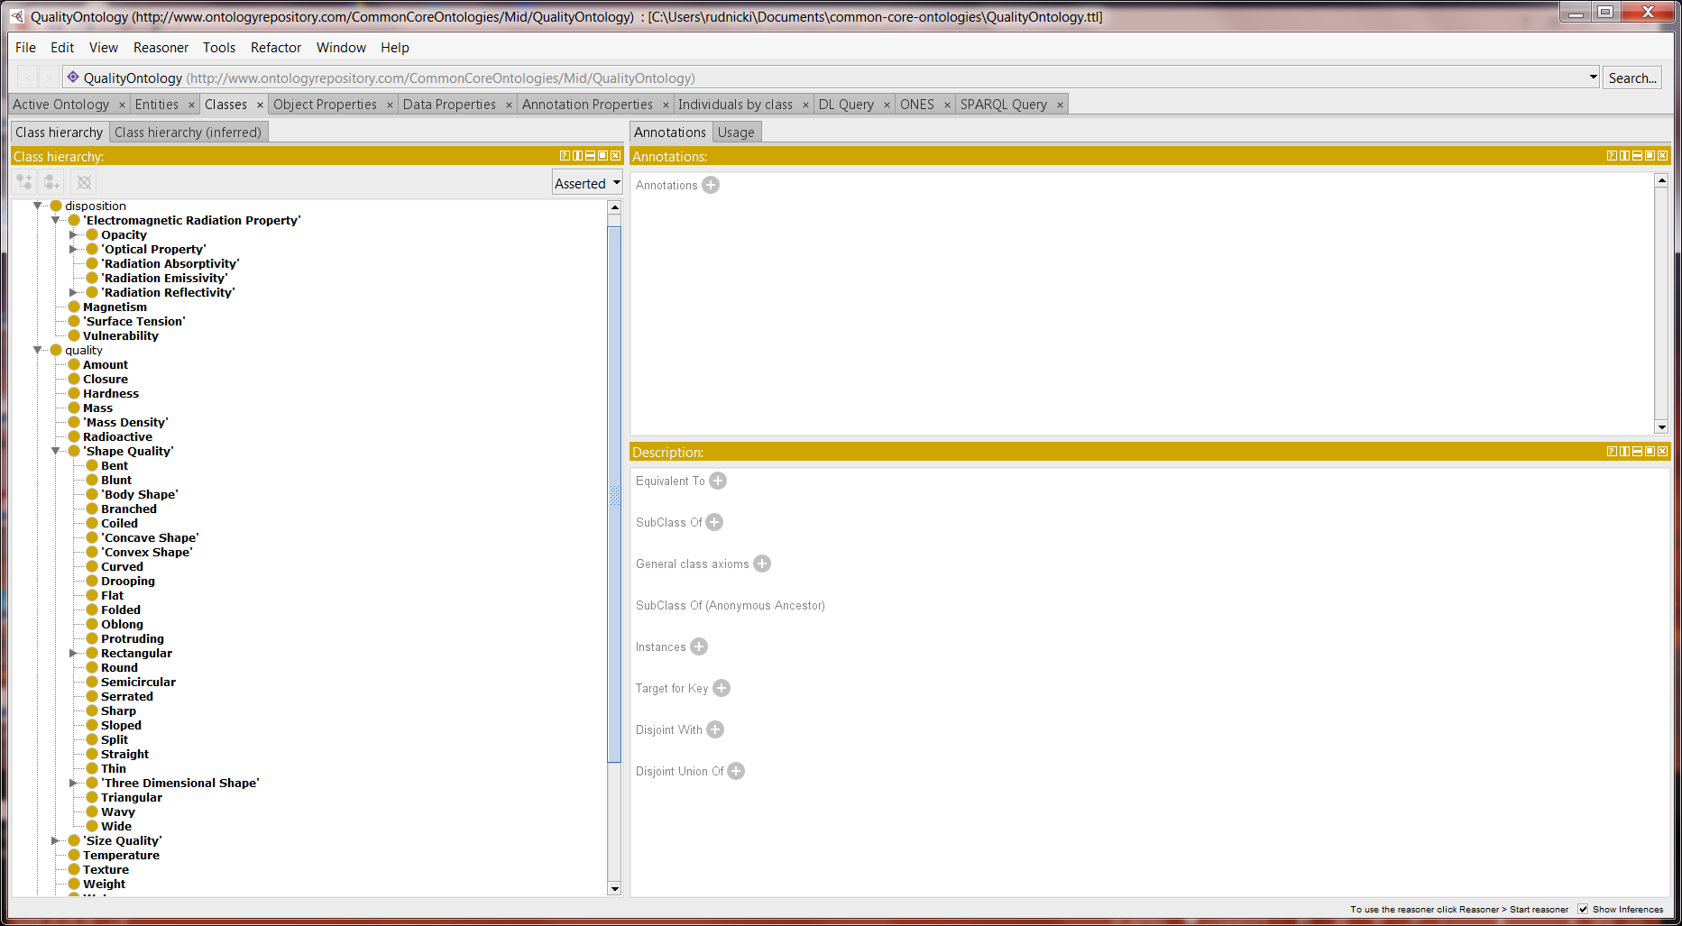
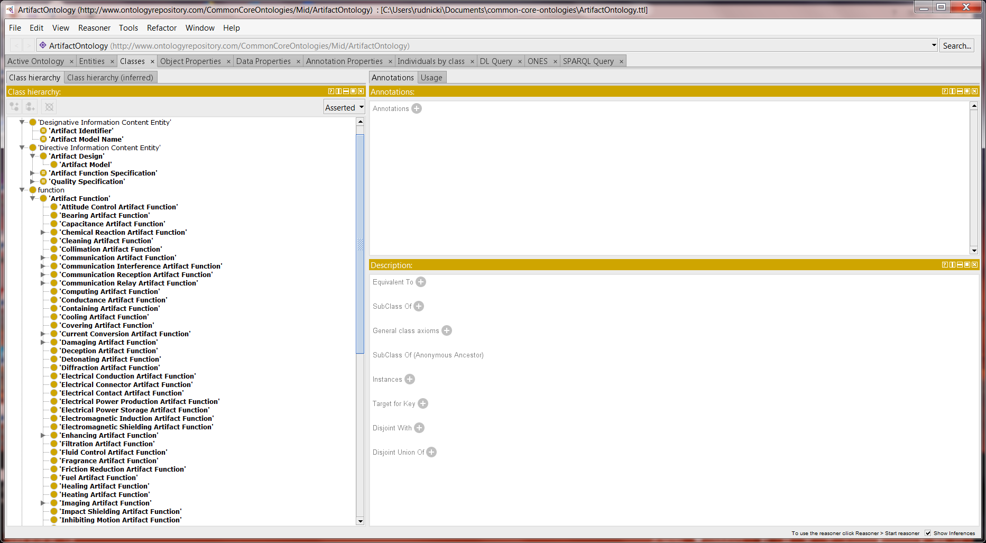
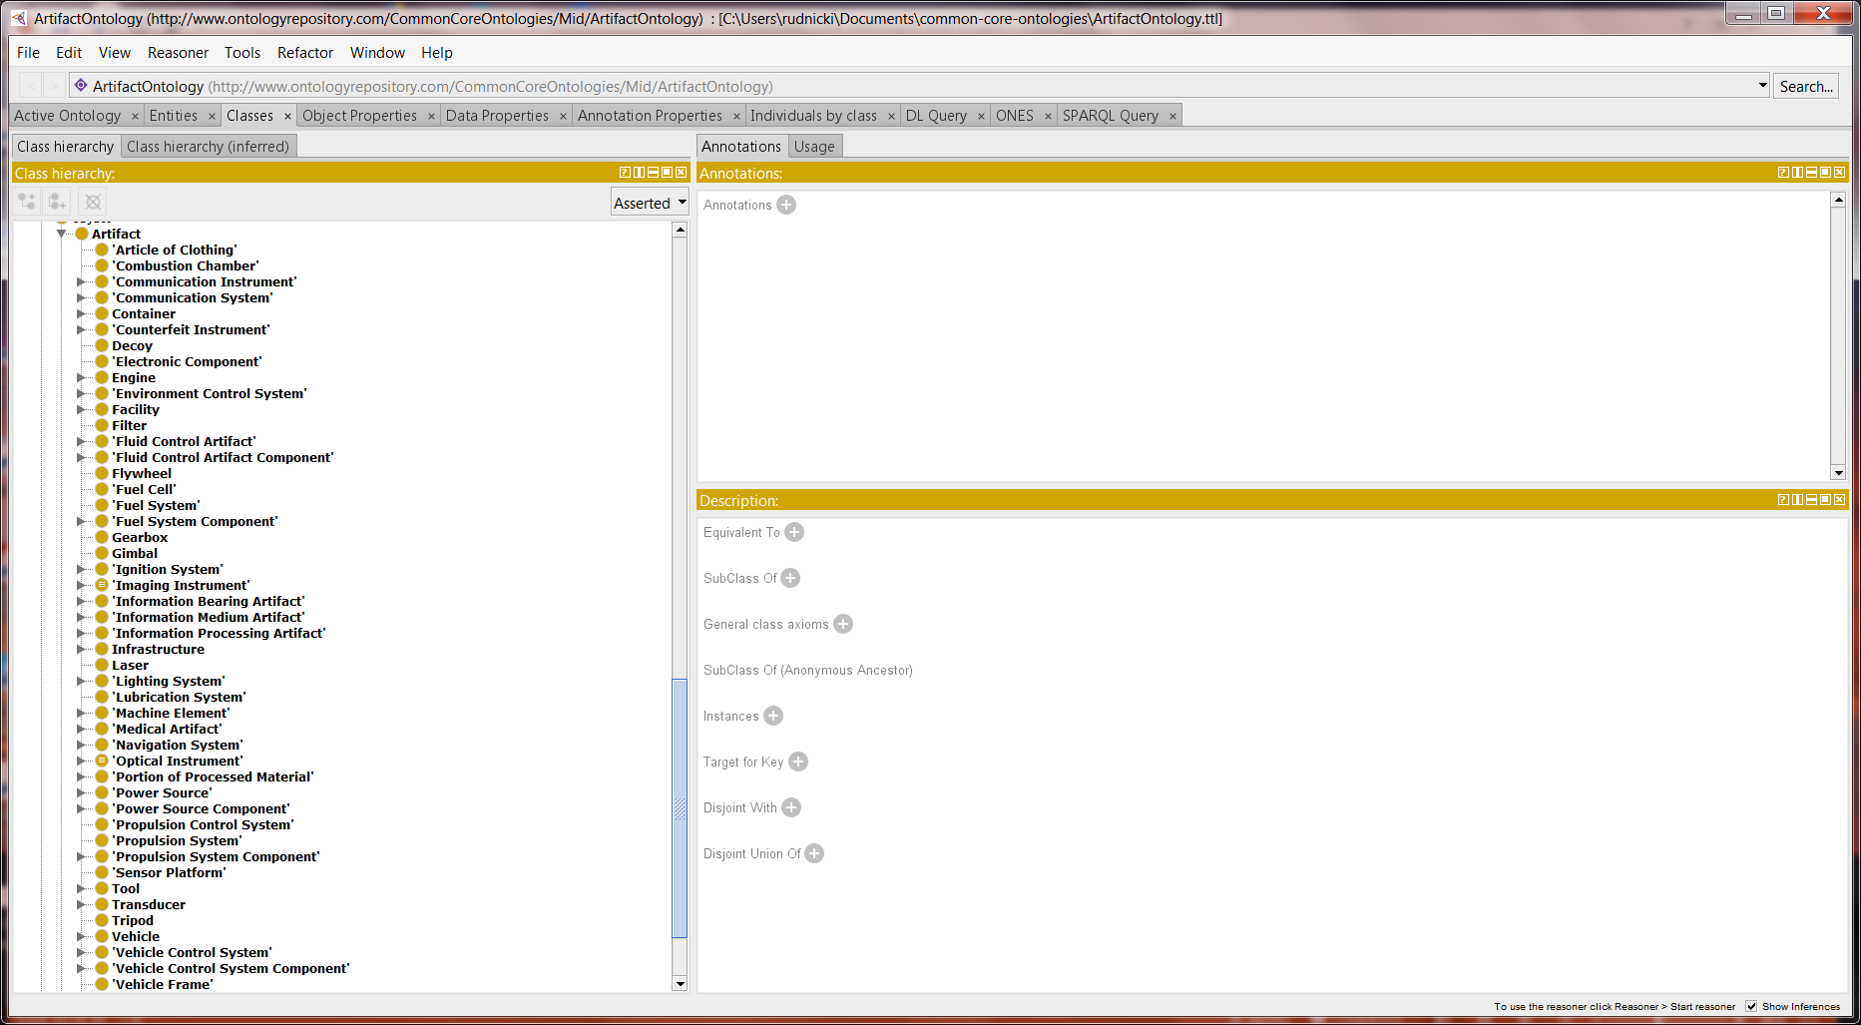
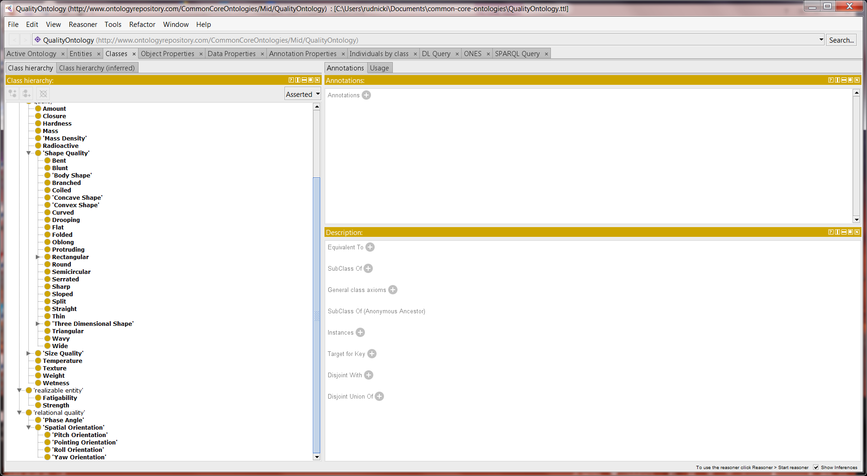
Quality and Artifact
Quality Ontology
Artifact Ontology

Slide 10
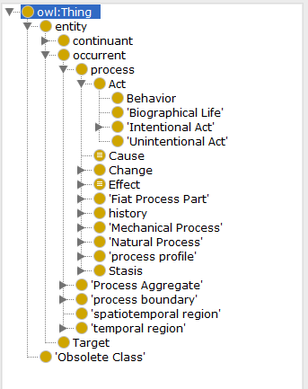
Event
Event Ontology

Slide 11
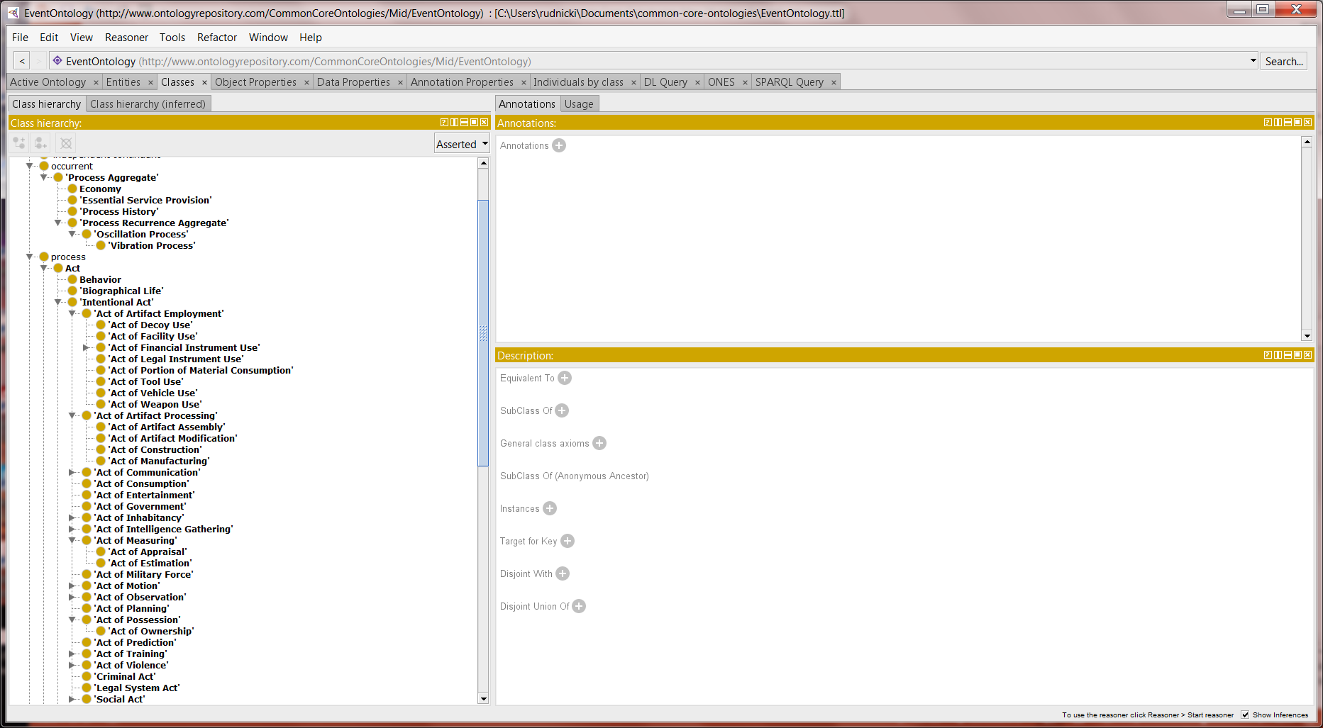
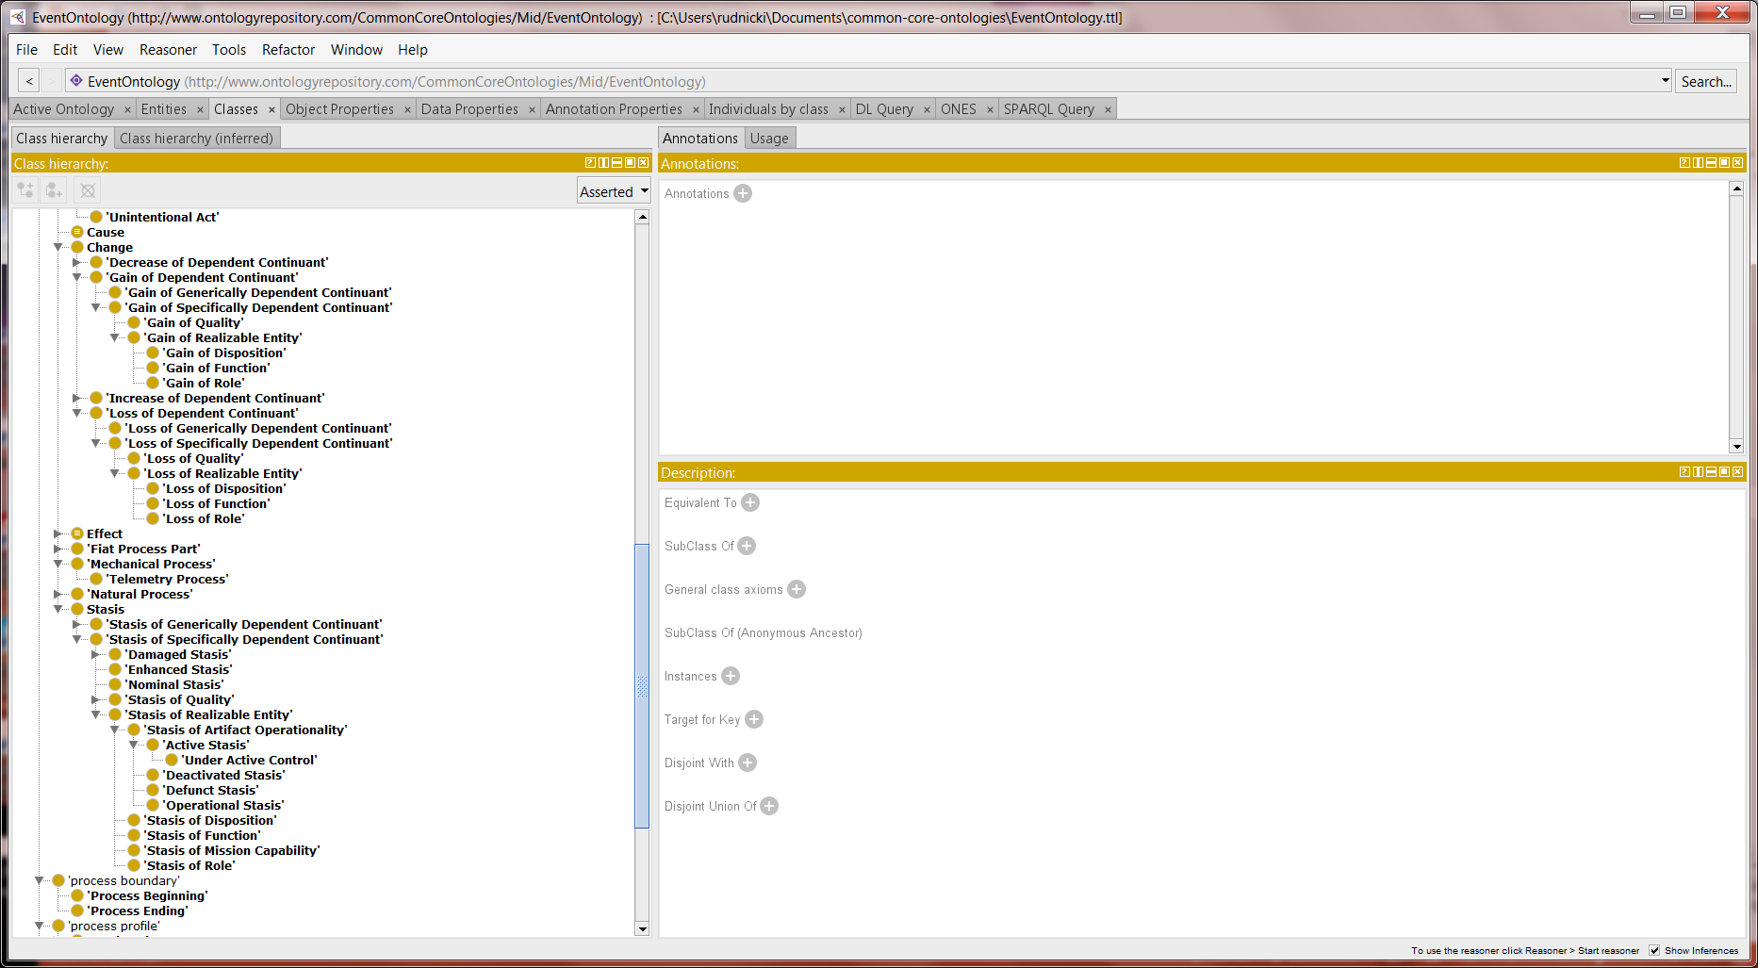
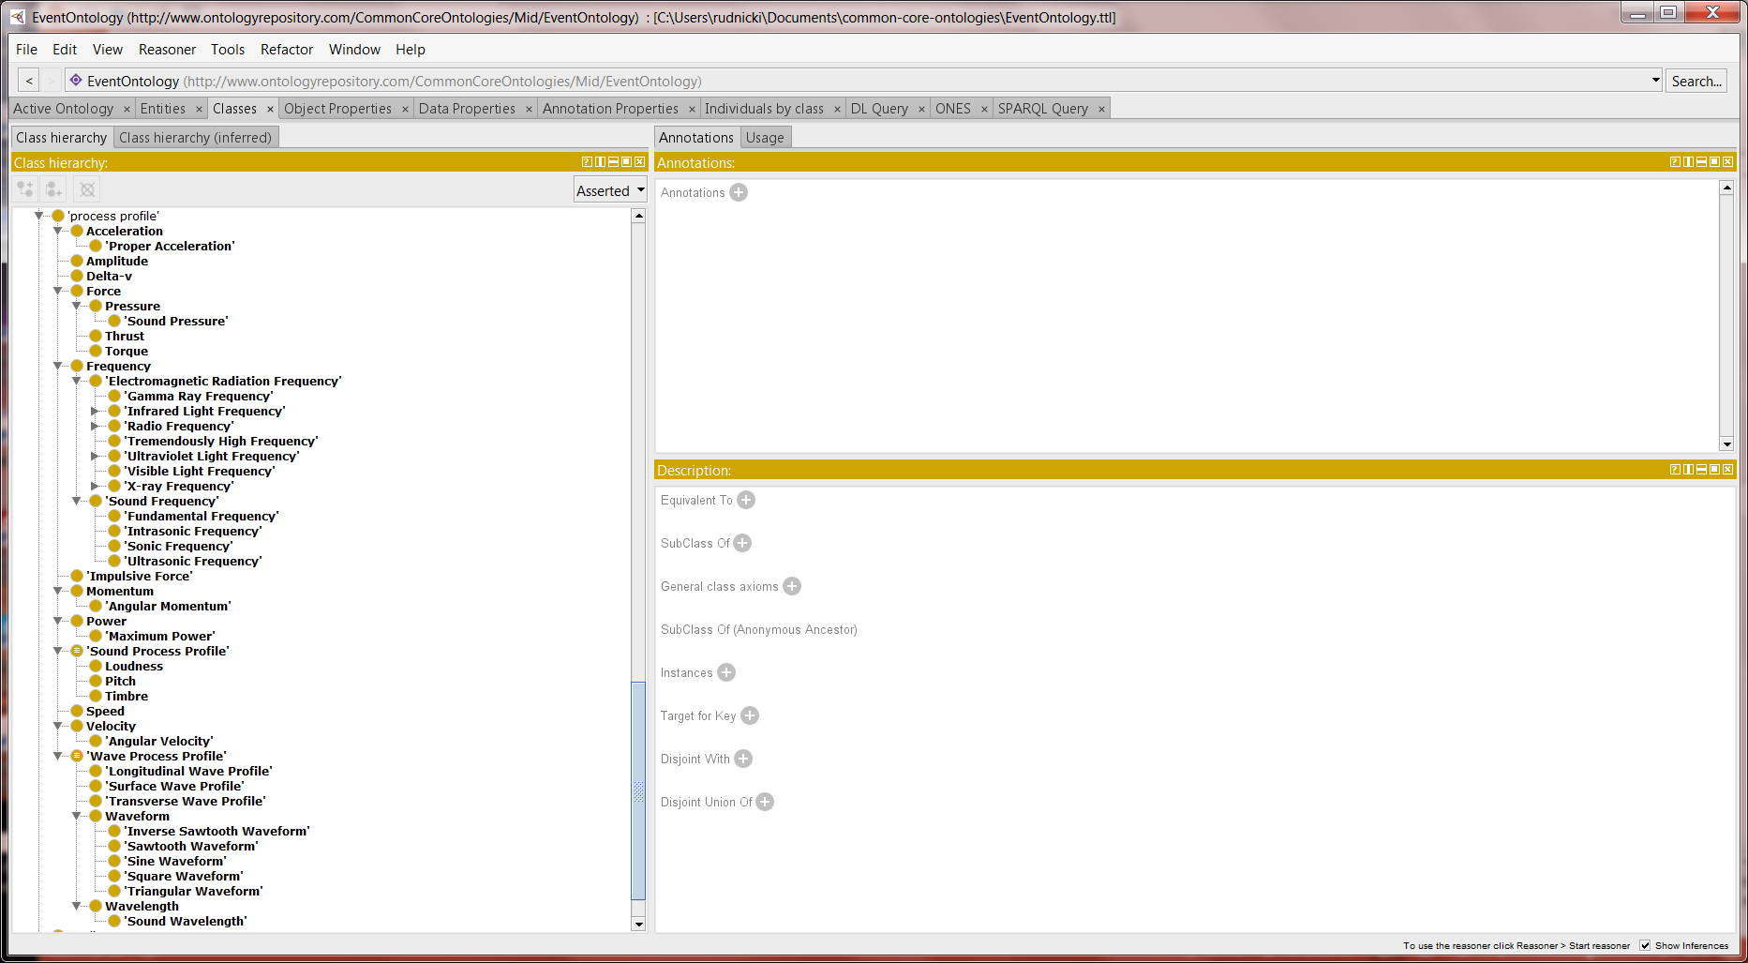
Event
Event Ontology

Slide 12
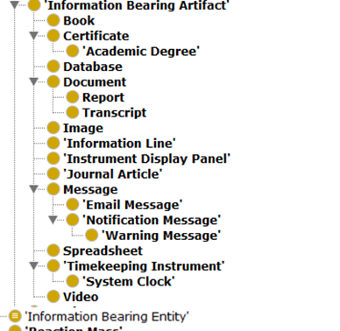
Information Artifact
Artifact Ontology

Slide 13
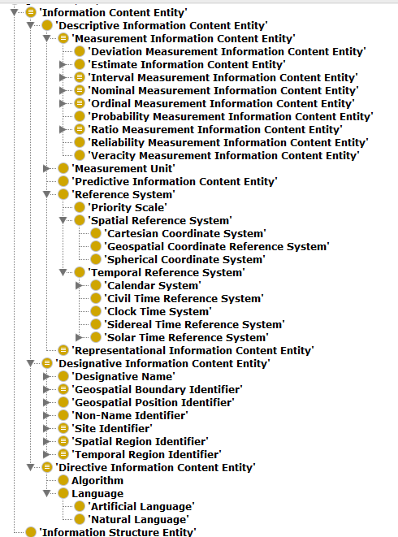
Information
Information Entity Ontology

Slide 14
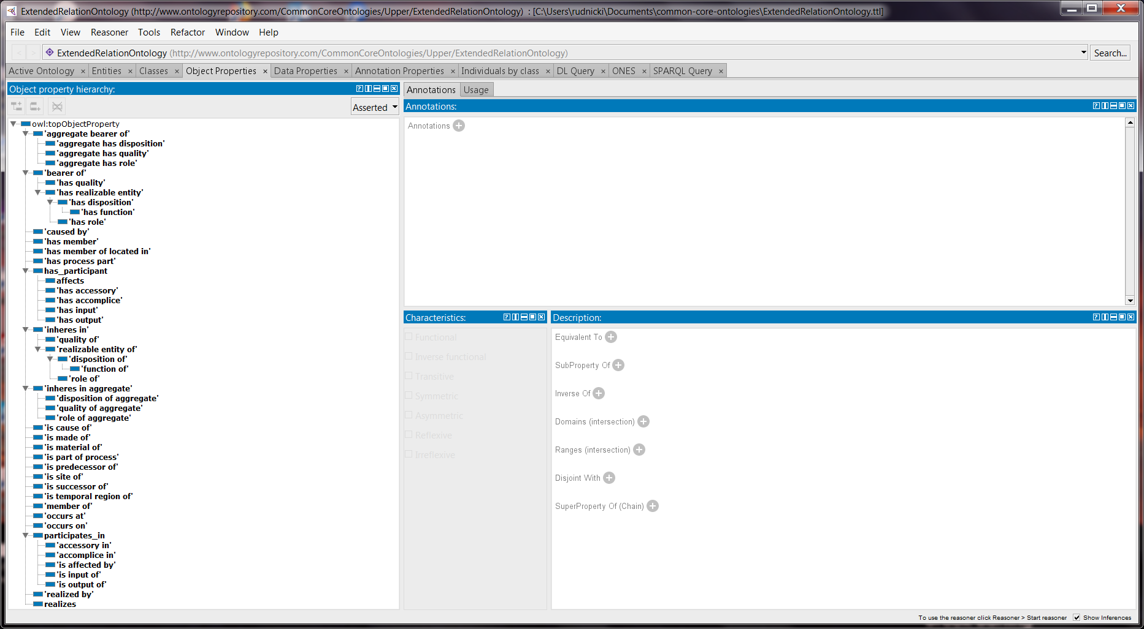
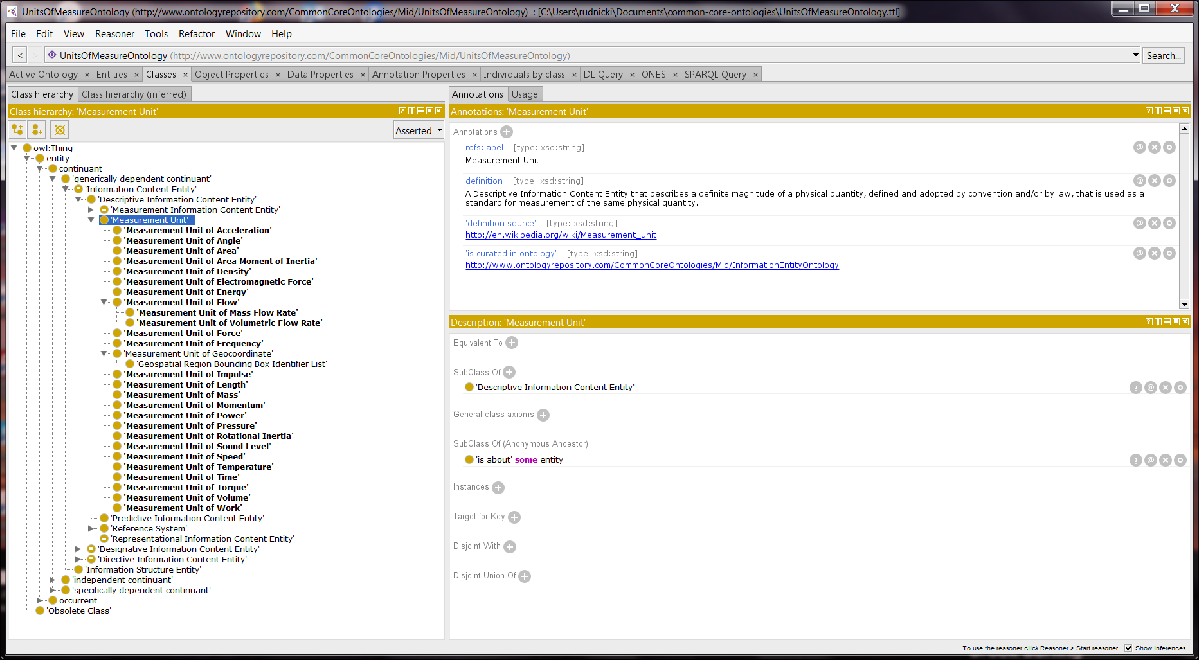
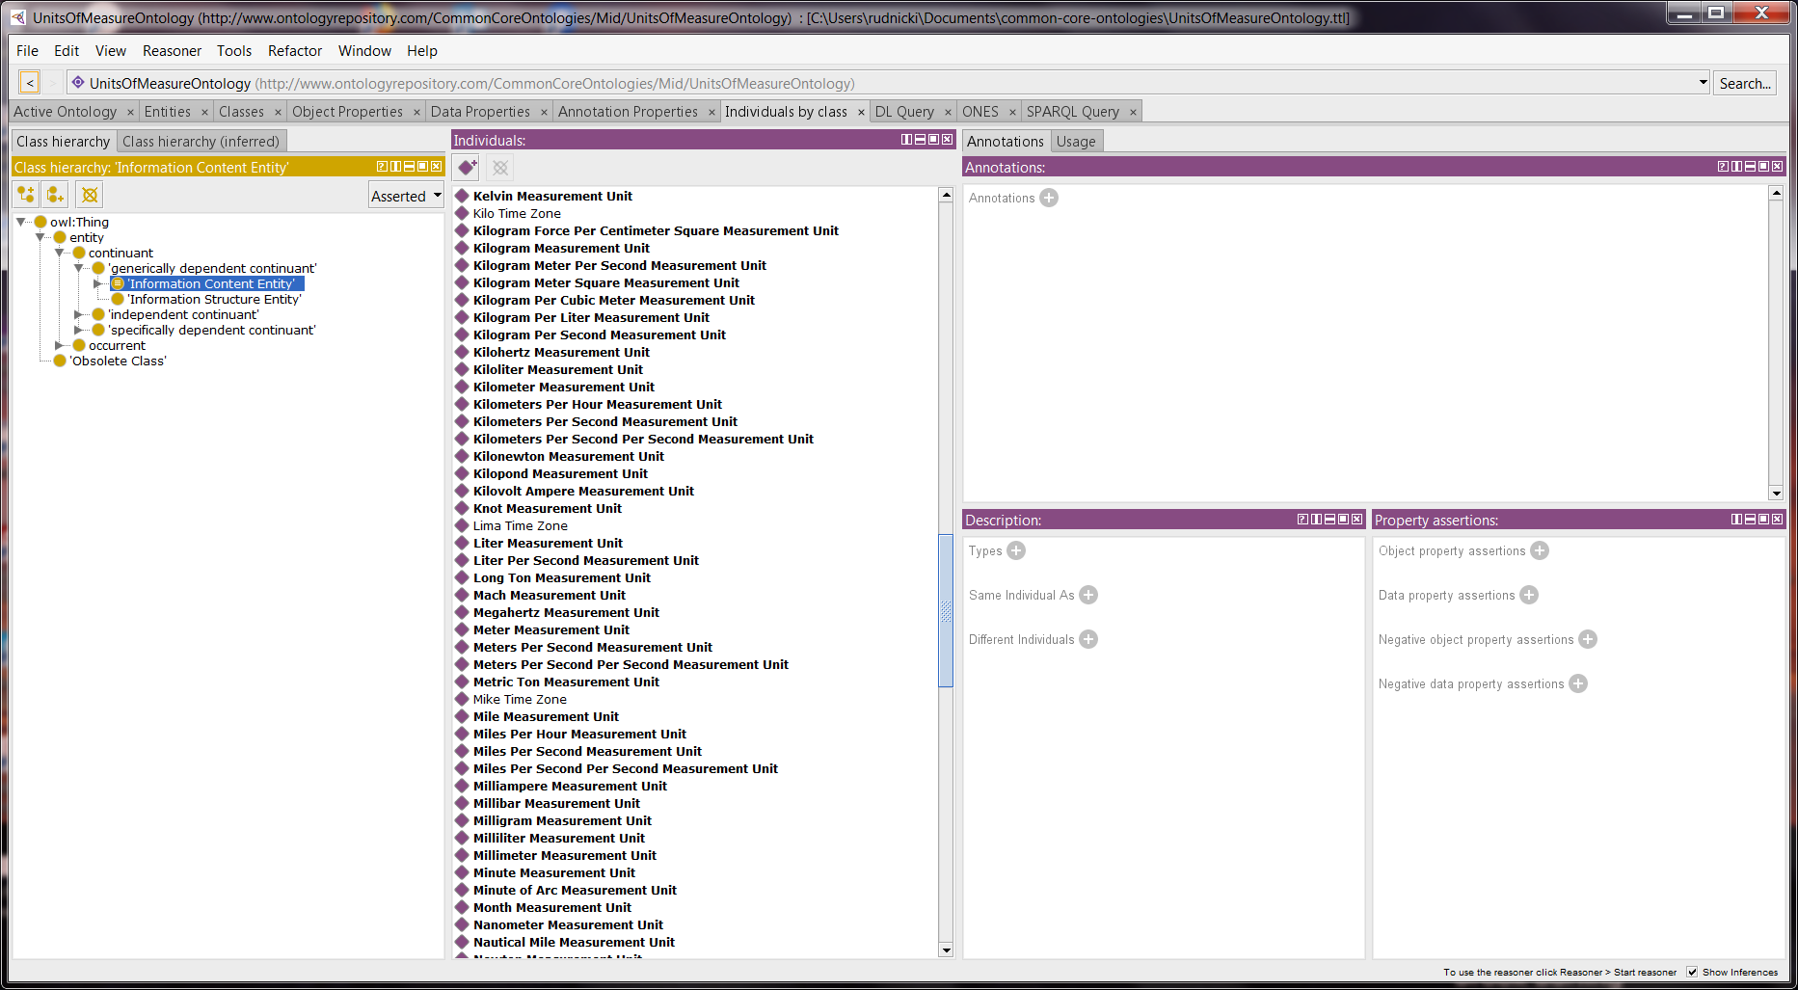
Extended Relation and Measurement Unit
Extended Relation Ontology
Measurement Unit Ontology

Slide 15
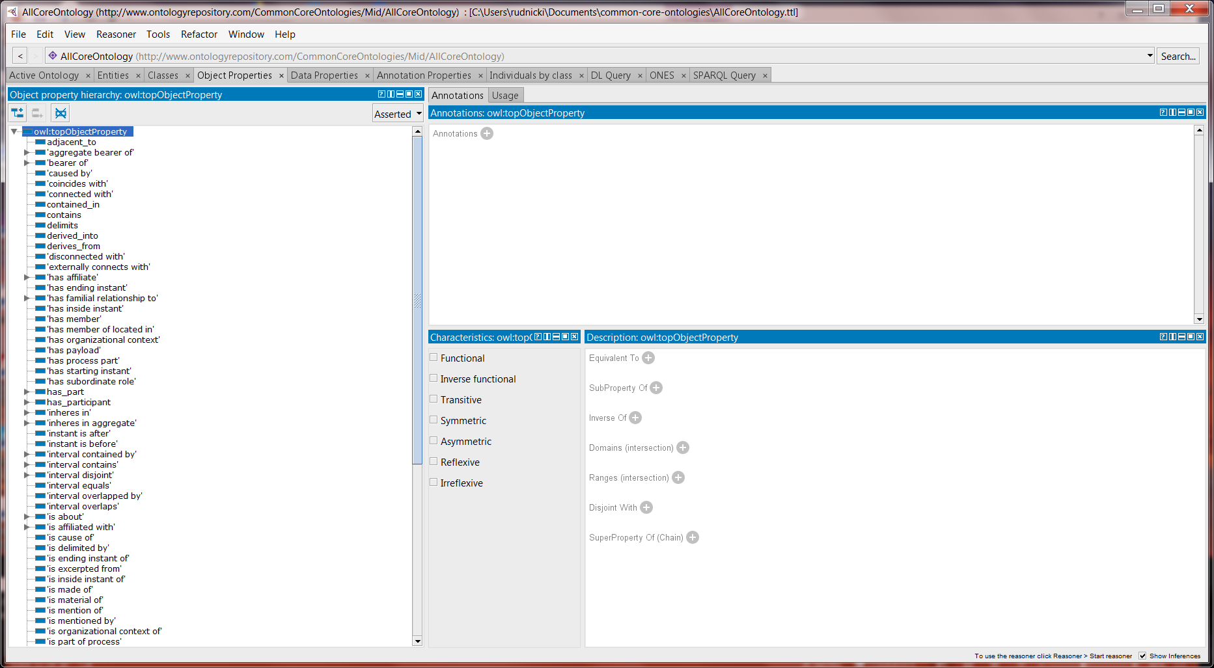
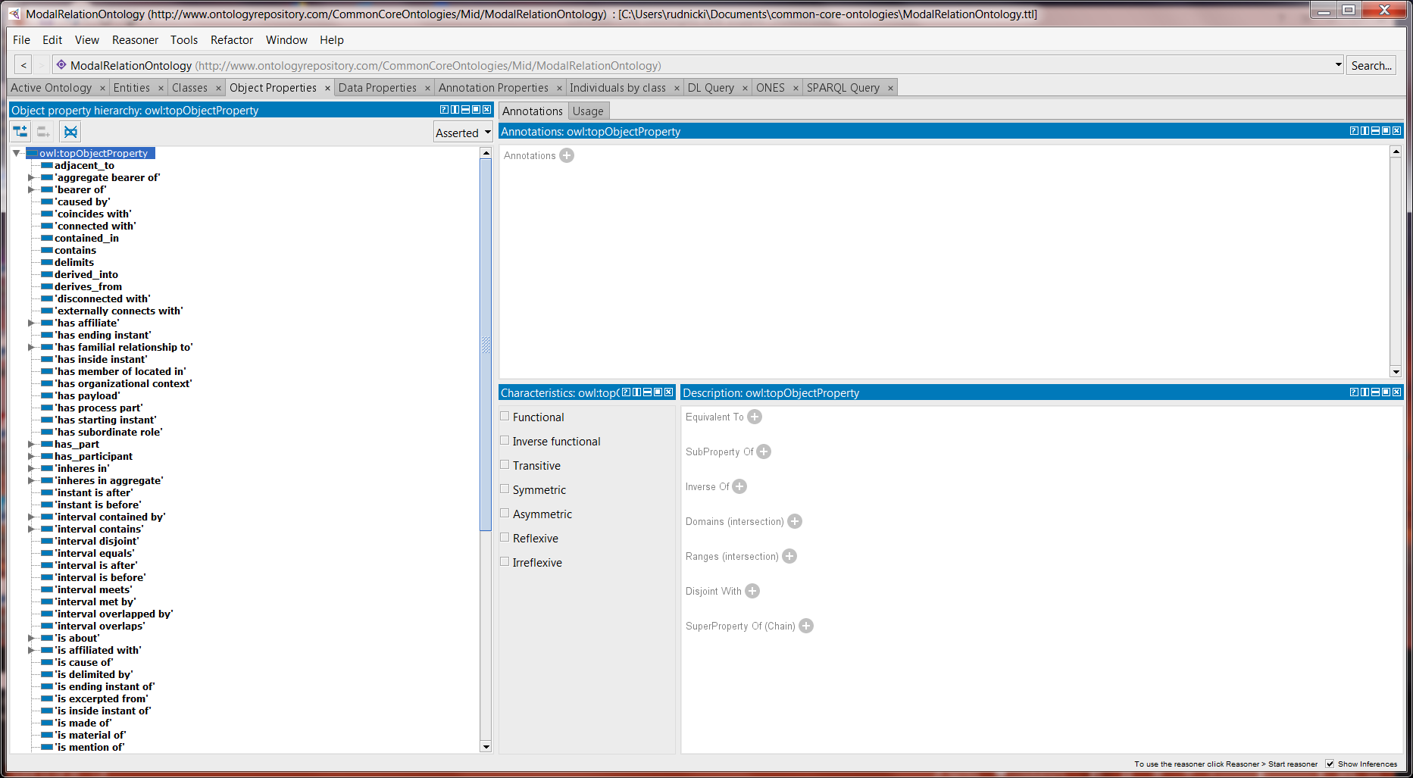
Extended Relation and Modal Relation
CCO Object Properties
Modal Relation Ontology

Slide 16
BFO
Basic Formal Ontology
CCO
PLC
Extended Relation Ontology
Geospatial Ontology
Time Ontology
Information Entity Ontology
Event Ontology
Quality Ontology
Agent Ontology
Artifact Ontology
Units of Measure Ontology
Currency Unit Ontology
Modal Relation Ontology
All Core Ontology
All CHAMP Ontology
Commercial Entities Ontology
Product Life Cycle Ontology
Services Ontology
Design Ontology
Testing Processes Ontology
Maintenance Process Ontology
Manufacturing Processes Ontology
Machine and Tool Ontology
Notes:
What we are presently missing here is an end-of-life domain ontology that would cover disposal and recycling.

Slide 17
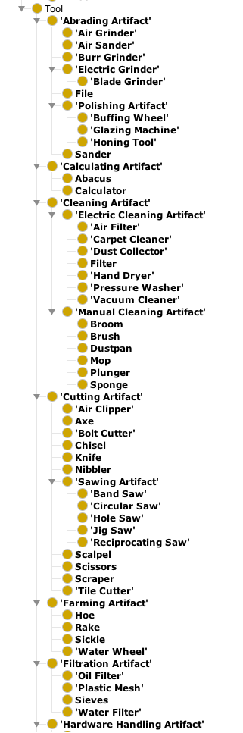
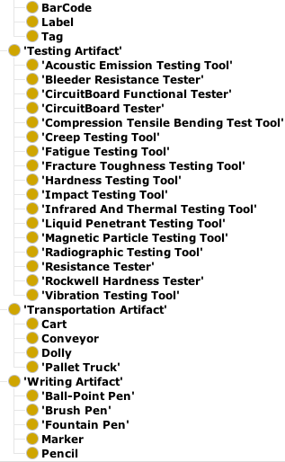
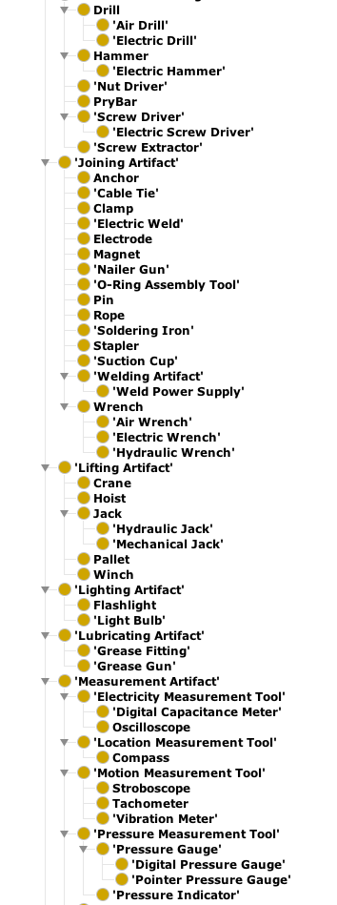
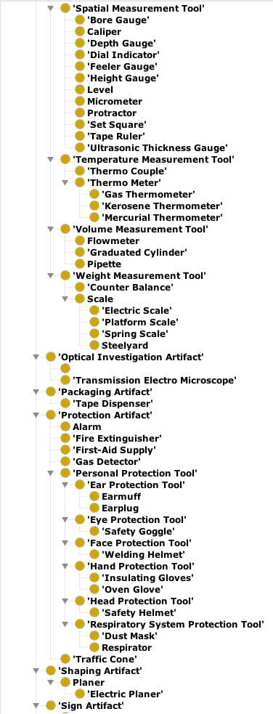
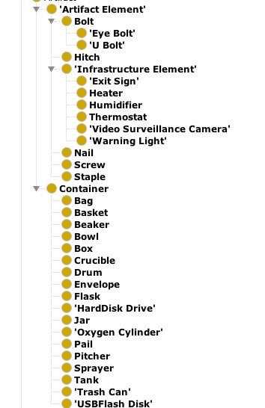
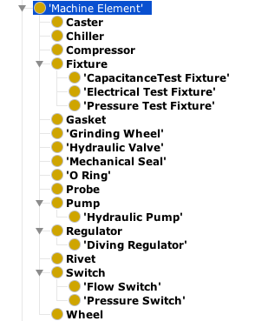
Machine and Tool Ontology

Slide 18
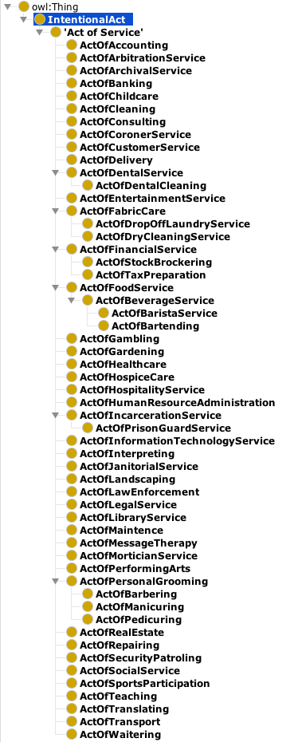
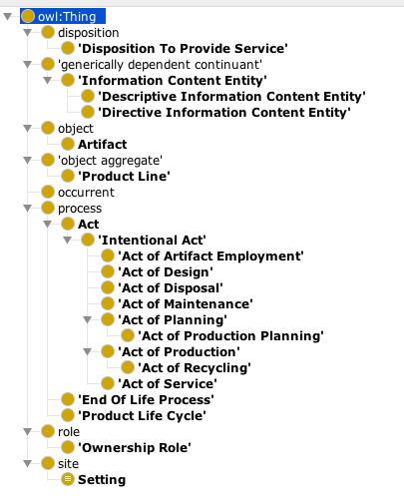
Product Life Cycle Ontology
Service Ontology

Slide 19
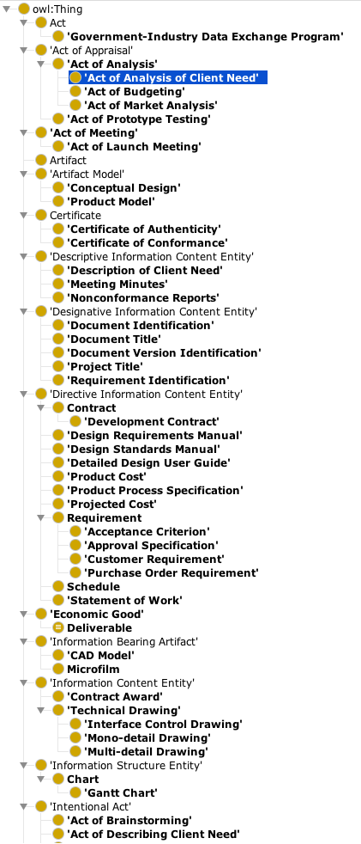
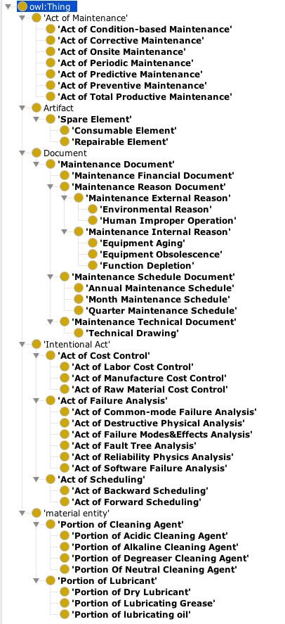
Design Ontology
Maintenance Process Ontology

Slide 20
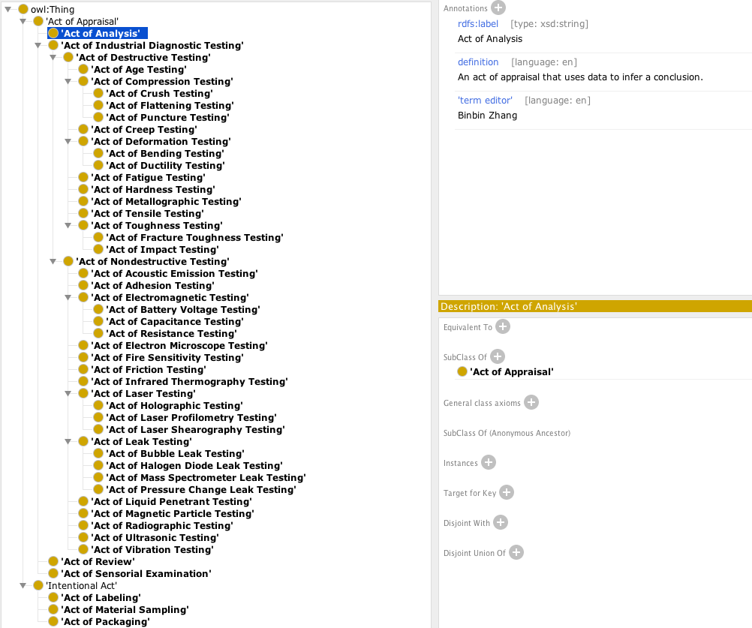
Testing Process Ontology

Slide 21
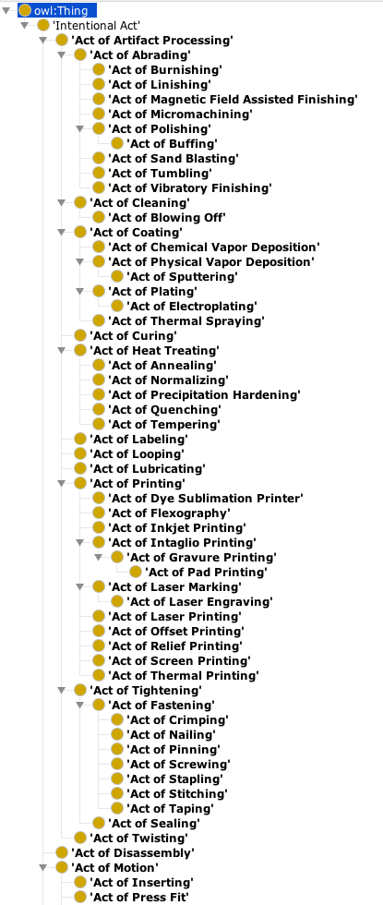
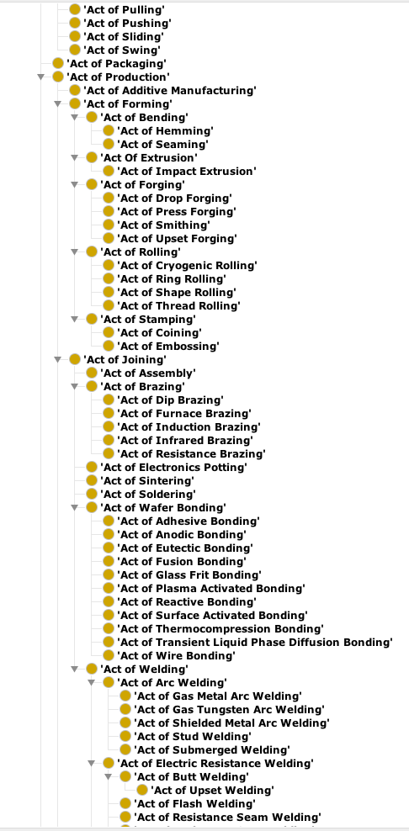
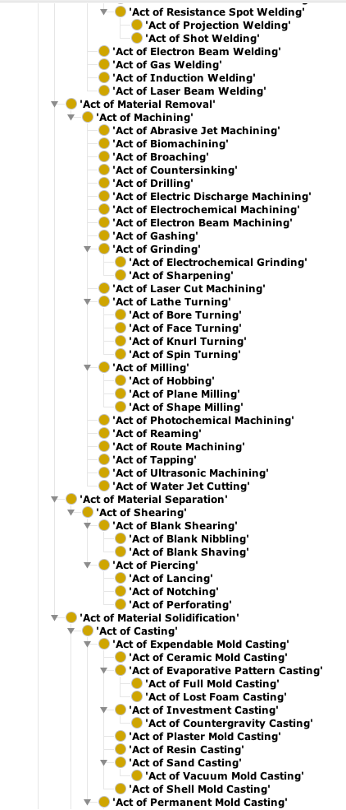
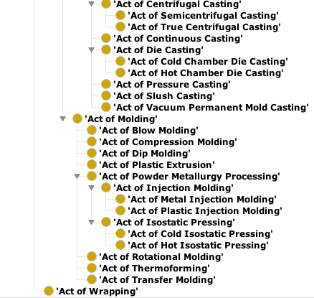
Manufacturing Process Ontology

Slide 22
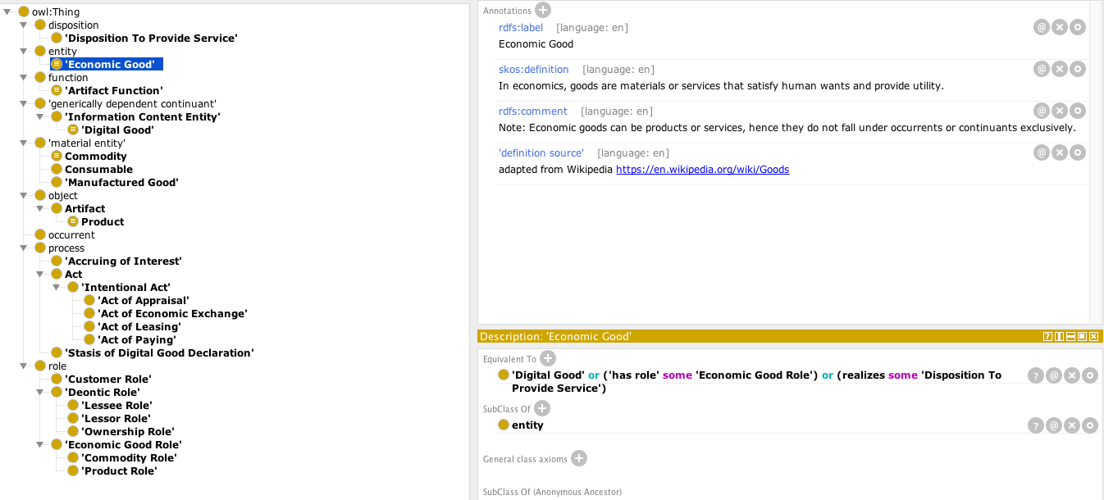
Commercial Entity Ontology

Slide 23
Other Ontologies Under Development:
Addictive Manufacturing (AM) Ontology
Functionally Graded Materials (FGM) Ontology
Semantic Knowledge Management System for Laminated Composites (SLACKS) Ontology
Materials Property Ontology (formally MatOnto)

Slide 24
Links to the Product Life Cycle Github Repository
All ontology files, along with these slides, may be found at:
https://github.com/NCOR-US/CHAMP
Slides from talk on Cases, Lessons, and Best Practices (NIST workshop 4.24.18)
https://github.com/NCOR-US/CHAMP/blob/master/NIST%20IOF%20Presentation%204.24.18.pptx
Slides showing how to represent ‘quality’ (in the sense of a ‘good product’) using CCO/PLC
https://github.com/NCOR-US/CHAMP/blob/master/Against%20Qualities%20in%20the%20Value-laden%20sense.pptx
Questions: J. Neil Otte, (neilotte@gmail.com)

